Slide 1

Interactions between stages of the Computer Vision pipeline, identifying dependencies and presenting them using integrated visual frameworks.
COURSE CODE:ITA0518-COMPUTER VISION
PRESENTED BY
K. PRAVALLIKA(192312338)-ECE
Guided by
Dr.T.M.USHA

Slide 2


Introduction
Computer Vision is a branch of Artificial Intelligence that enables computers to acquire, process, analysis, and interpret visual information from images and videos.
The Computer Vision pipeline consists of several interconnected stages, where each stage performs a specific task and passes its output to the next stage.
The performance of the entire system depends on how effectively these stages interact with one another.
Understanding these interactions helps in designing robust, accurate, and efficient vision systems for real-world applications.
Notes:
Image source: https://ae01.alicdn.com

Slide 3
Computer Vision Pipeline
The Computer Vision pipeline is a systematic sequence of operations that transforms a real-world scene into meaningful information.
It begins with image acquisition, where visual data is captured using cameras or sensors.
The captured image is then preprocesses to remove noise and improve quality. Feature extraction identifies important image characteristics such as edges, corners, textures, and shapes.
Segmentation divides the image into meaningful regions, followed by object detection and classification, where objects are recognized and assigned labels.
Finally, the extracted information is used for decision-making in various applications.
Notes:
Image source: https://www.build-electronic-circuits.com

Slide 4
Image Acquisition and Its Dependencies
Analog image acquisition is the process of capturing a real-world scene in the form of a continuous signal without converting it into discrete values.
In this method, light from the scene is sensed and directly transformed into an electrical signal that varies smoothly with intensity.
Unlike digital systems, analog acquisition does not involve sampling or quantization, so the image information remains continuous.
This results in smooth intensity variations but makes storage, processing, and analysis more difficult.
Analog image acquisition was commonly used in older systems such as film cameras and traditional CCTV cameras, and it forms the basic foundation for modern digital imaging systems.

Slide 5
Image Preprocessing
Image preprocessing improves image quality before further analysis. It removes unwanted noise, corrects illumination problems, enhances contrast, and sharpens important details.
Common preprocessing techniques include:
Noise filtering
Histogram Equalization
Contrast Stretching
Gamma Correction
Image Sharpening
Preprocessing directly depends on the quality of the acquired image. If preprocessing is ineffective, feature extraction and segmentation accuracy decrease significantly.
Notes:
Image source: https://thumbs.dreamstime.com

Slide 6
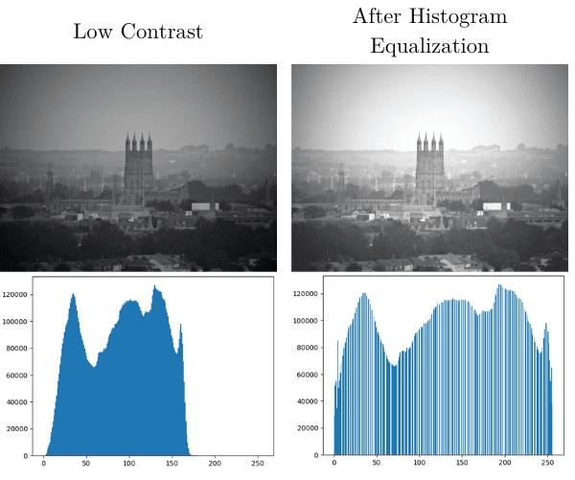
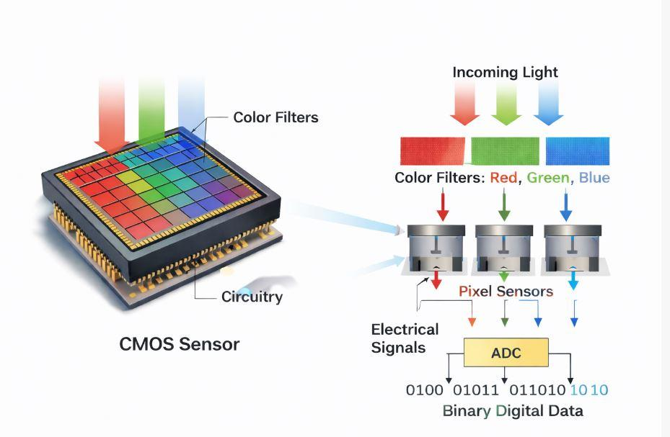
Image Acquisition
Examples
Image Preprocessing

Slide 7
Interactions Between Pipeline Stages
Each stage of the Computer Vision pipeline is strongly interconnected. The output generated by one stage serves as the input for the next stage.
Consequently, the performance of later stages depends entirely on the quality of previous processing.
For example:
Poor image acquisition results in noisy images.
Noisy images reduce preprocessing effectiveness.
Poor preprocessing affects feature extraction.
Weak features reduce segmentation accuracy.
Incorrect segmentation causes object detection failures.
Detection errors lead to incorrect classification.
Notes:
Image source: https://www.slidemake.com

Slide 8
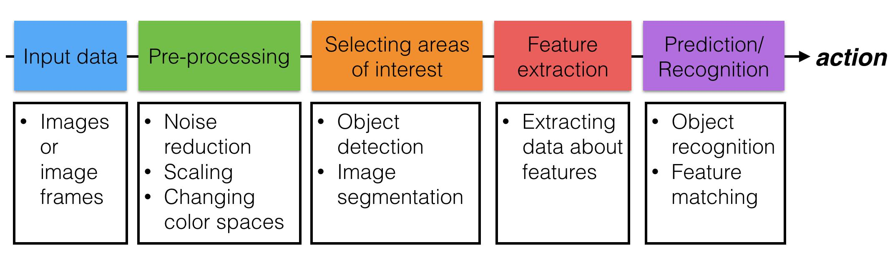
BLOCK DIAGRAM
Notes:
Image source: https://teachingwriting.stanford.edu

Slide 9
Applications
The interaction between pipeline stages plays an important role in various real-world applications, including medical image analysis, autonomous vehicles, robotics, industrial quality inspection, satellite image analysis, agriculture, and biometric systems.
However, several challenges affect pipeline performance, including image noise, uneven illumination, motion blur, occlusion, varying object scales, computational complexity, and real-time processing requirements.
Addressing these challenges requires careful coordination between all stages of the Computer Vision pipeline.
Notes:
Image source: https://img.electronicdesign.com

Slide 10
CONCLUSION
The Computer Vision pipeline consists of multiple interconnected stages that work together to transform raw images into meaningful information.
Each stage depends on the successful completion of the previous stage, making their interactions critical for system performance.
A well-designed pipeline with effective dependencies improves image quality, feature extraction, segmentation, object recognition, and final decision-making.
Understanding these interactions enables researchers and engineers to develop more accurate, reliable, and intelligent Computer Vision systems for a wide range of applications.
Notes:
Image source: https://i1.wp.com

Slide 11
CHALLENGES AND FUTURE WORKS
Computer Vision systems face several challenges, including poor image quality due to noise, blur, and low resolution, variations in lighting conditions, high computational complexity, object occlusion, and error propagation across different pipeline stages, all of which can reduce the accuracy and reliability of image analysis.
To address these challenges, future research focuses on developing advanced deep learning models for improved feature extraction and object recognition.
Explainable Artificial Intelligence (XAI) to improve model transparency, and designing intelligent integrated visual frameworks with adaptive feedback mechanisms to optimize interactions between pipeline stages and enhance overall system performance.

Slide 12
Thank you..

